Slide 1
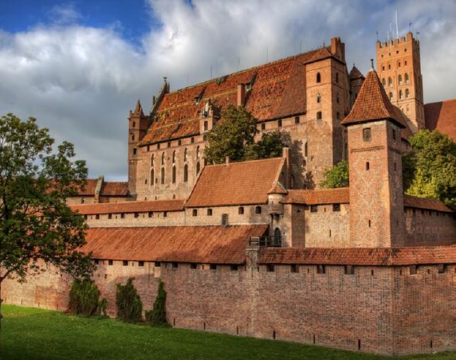
Castle in Malbork

Slide 2
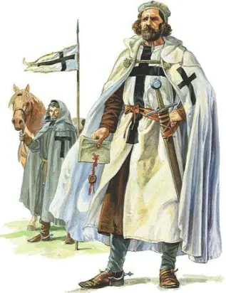
Bit of information
The castle in Malbork is a three-part defensive fortress in the Gothic style. It consists of a low ward, a middle ward and a high ward. It is one of the largest surviving complexes of Gothic architecture in the world. The original name of the castle used by the Teutonic Order was Marienburg, meaning Mary's Castle. From September 14, 1309 to 1457, the castle in Malbork was the seat of the Grand Master of the Teutonic Knights, and the city was the capital of the monastic state.

Slide 3
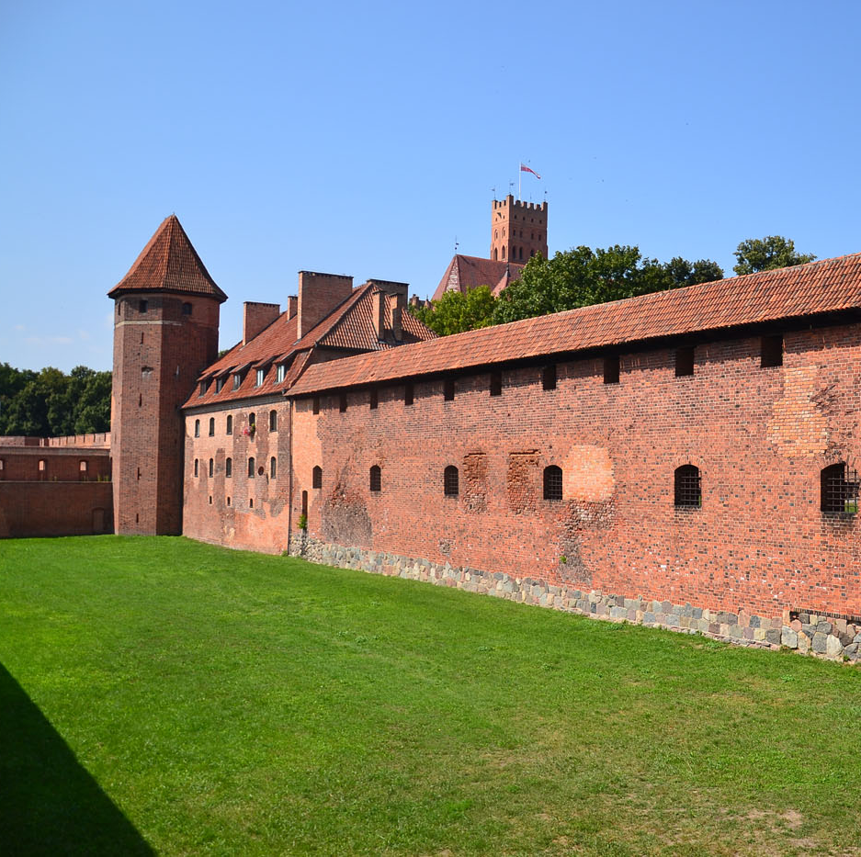
Low Ward
The Low Ward is the largest and, at the same time, the youngest part of the stronghold, mainly of an economic and warehouse character. It was located here, among others a bell-foundry, a crossbow house, a powder magazine, various workshops, stables and a caravan in which the weapons were stored (a building at a cash register). The west wing, where the restaurant is located today, was used by a hospital, a brewery, granaries and a cowshed. The entrance to the Middle Ward leads through a roofed wooden bridge from the north. This part of the castle was created from the former outer bailey when, after the capital of the order was moved to Malbork, the High Castle was no longer sufficient. Here you can see a powerful portcullis (lowered grate) preventing access to the castle. On the right side of the entrance there was an infirmary, that is the monastic hospital, while on the left the rooms of the grand commander, the second person in the order after the grand master.

Slide 4
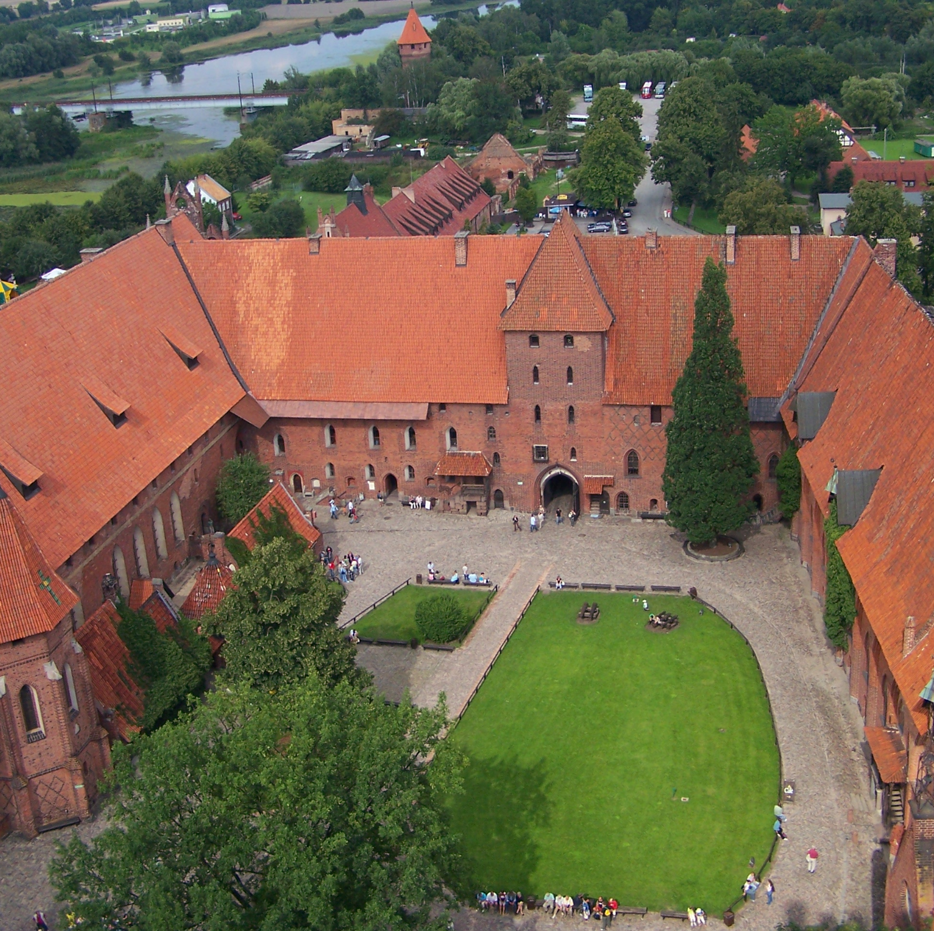
Middle Ward
The northern and eastern wings of the Middle Ward were managed by the grand commander, the second, after the grand master, figure in the castle. His tasks included control over the finances of the treasurer and steward. The Grand Commander also received some guests, therefore, in the eastern wing, rooms were prepared for them (there were, among others, rooms for knights coming from the West to provide armed support for the Order during the wars with Poland). The northern wing performed administrative and residential duties, while the southern wing was not at all. This solution made it possible to observe from the High Ward what was happening in the Middle Ward. The lack of fortifications and buildings on that side also put any intruders who wanted to take the High Ward by storm. In the north-west corner of the complex there was a large infirmary, that is a hospital for old or sick religious brothers. The gate passage arranged in the northern wing had three safeguards. The first was a drawbridge, the second was the harrow and the gate's neck, and the third was another harrow and a shooting range. The Middle Ward from the north and east was secured by an additional wall line, and the whole was surrounded by a moat

Slide 5
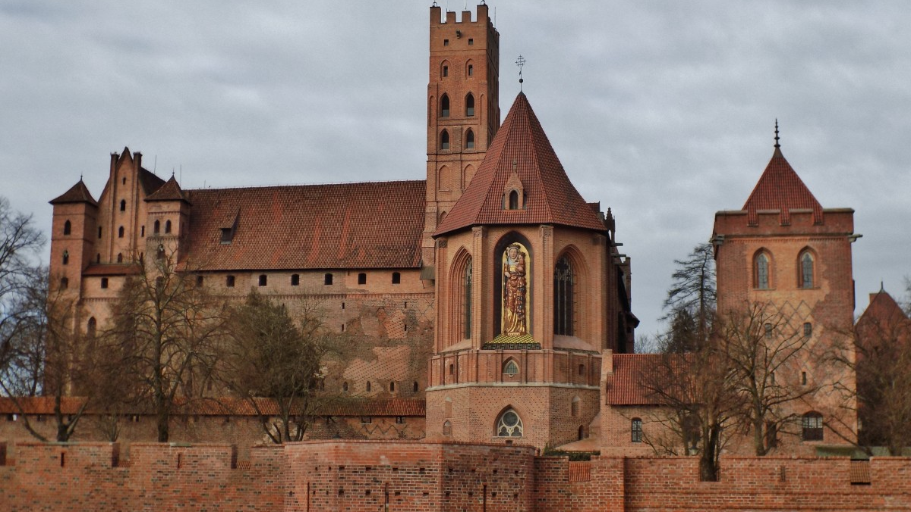
High Ward
The High Ward was led by a gate located in the north-west corner of the quadrilateral, which was accessed via a wooden drawbridge. In the gate's neck there were two side gates leading to the outer areas of the High Ward intended for guards. The main gate was located in a niche about 13 meters high, equipped with an overhung bay window through which the besiegers were struck. The passages were closed with lowered harrows. Next to the chapel, in the eastern wing of the castle, there is a high, 66-meter tower, which initially served as a church belfry, and after the superstructure, it was also used as an additional element of fortifications, as well as a signaling point enabling, by means of smoke and fire signs, to quickly send messages between the neighbors monastic centers. On the north side, the so-called the tower with a claw, flanking the approach to the entire castle complex and gate. It towered over the Middle Ward, providing the crew of the High Ward with a favorable fire position in relation to possible attackers.

Slide 6
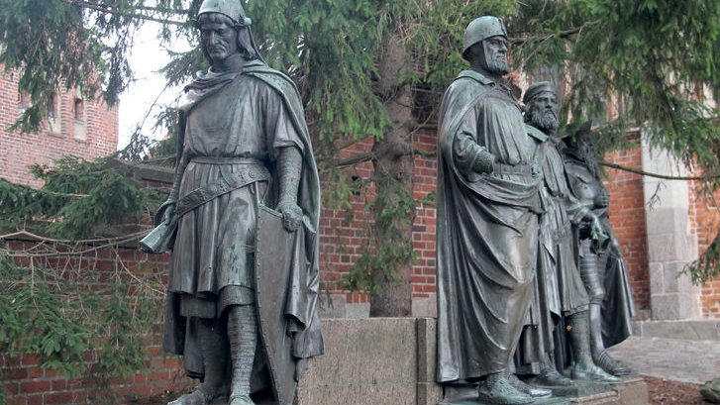
The Capital of the Order
On September 14, 1309, Grand Master Zygfryd von Feuchtwangen moved the capital of the Teutonic Order from Venice to Malbork. Why did he do it? In Western Europe, an atmosphere of hostility towards the order was growing due to the conquest of Christian lands instead of pagan lands. The wave of accusations and persecution against the Templar Order also greatly disturbed the Grand Master. He was afraid of similar actions against the Teutonic Knights. Moving to distant Prussia seemed a necessity. Certainly a more suitable place for the capital of a powerful order would be Elbląg, but there were predominantly supporters of Henryk von Plotzke, the national master, who unscrupulously pursued the conquest of new lands and completely disregarded the real functions and tasks to which the order was established. He was Feuchtwangen's greatest opponent within the order, so he made Marienburg or Malbork his capital. From then on, the grand master and his deputy grand commander resided in the castle.

Slide 7
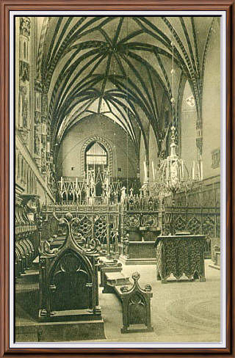
Hidden altar
In Malbork's art work law - an intricately carved field altar by master master Ulrich von Jungingen. Poles captured it after the Battle of Grunwald. Over the centuries, a king will be raised in the cathedral, where it was given as a gift from Władysław Jagiełło. However, after the partition of Poland, the Prussians stole it and deposited it in Malbork. During the war in 1945, Poles tried to check the castle in order to reduce the number of disks. Despite this, many of the creators have been lost or hidden. Soon a group of people was noticed at night behind the walls, who had entered the castle through an unknown passage. There was a manhunt, but the intruders firing at each other with automatic escapees. However, they lost the document that led the Poles to a house, where a valuable altar wrapped in the cloak of the German gendarmerie was found in a hiding place in the basement. In contrast, a newly made hole was discovered in the treasury at the High Ward. That's where the hidden secret was. The recovered valuable monument became an exhibit of the National Museum in Warsaw.

Slide 8
During the Thirteen Years' War, in 1457, Malbork was occupied by Polish troops. The management rested in the hands of the royal staroste and his burgrave. The presence of 16th - 18th century inspections of the building formed by court officials shows that the functions of some of its parts have changed. The High Ward ceased to be considered as tendencies to be confined to a fortress. Tar, salt, beer, hops and other food products were stored here. The military crew and clerks lived in the Middle Ward. The outer ward was adapted for the necessary purposes. Cannons, bullets and other small arms were stored in Karvana. In the towers and towers - barrels with gunpowder and saltpetre.

Slide 9
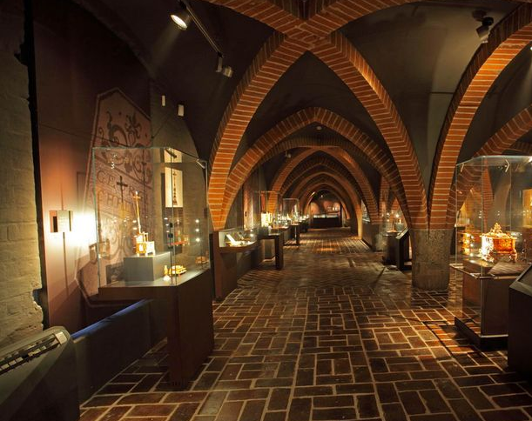
Museum
On January 1, 1961, the Castle Museum was established. The decision to establish it was accelerated by the dangerous fire of the roofs of the western and northern wings of the Middle Ward, which broke out on September 7, 1959. On July 3, 1965, in the partially rebuilt eastern wing, an amber exhibition was opened, which is one of the magnets attracting crowds of tourists to Malbork. Another attraction are the shows of the shows "Light and Sound". (since 1980). In December 1997, the castle complex was inscribed on the UNESCO World Cultural Heritage List.

Slide 10
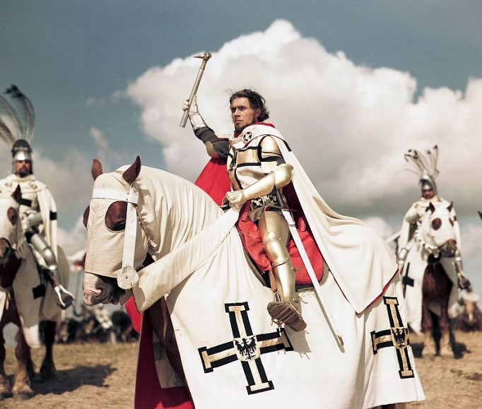
Teutonic Order
The Teutonic Order (full name - the Order of the Hospital of Our Lady of the German House in Jerusalem), is one of the largest knightly orders that arose in the 12th century as a result of the crusades. The Teutonic Knights conquered East Prussia and the territories of Latvia, Estonia, and Polish lands. The famous seat of the Teutonic Knights is the castle in Malbork (Malbork). Malbork became the place of the Teutonic Knights as a result of their arrival by Konrad Mazowiecki

Slide 11
THE END

