Slide 1
Handball
Team games

Slide 2
Game rules:
- the team consists of 7 players
- game time – 2 x 30 minutes
- the break is 10 minutes

Slide 3
- the ball may by thrown, pushed, caught, stuck
- the player may not dribble the ball
- the player can hold the ball for 3 second
- the team with the most goals wins

Slide 4
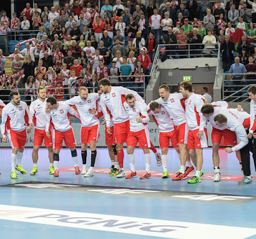
Famous players from Poland:
- Sławomir Szmal
- Karol Bielecki
- Bogdan Wenta
- Michał Jurecki
- Kinga Achruk
- Joanna Drabik

