Slide 1
Traditional Polish cuisine

Slide 2
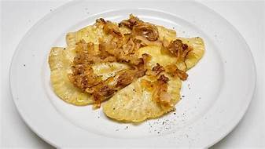
Russian dumplings
Components / 75 pieces
500 g of white or semi-fat cheese
500 g of potatoes
2 teaspoons of salt (or to taste)
½ teaspoon of ground herbal or black pepper

Slide 3
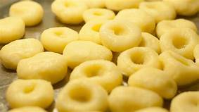
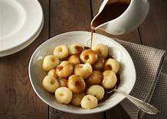
Silesian noodles
Components / 3 servings / about 30 pieces
About 500g of boiled potatoes
Potato flour / potato starch
1 egg
salt

Slide 4
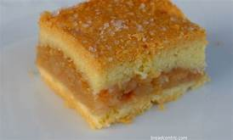
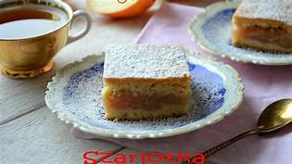
Apple pie
Components / 12 servings
Cake:
300 g of flour
250 g cold butter (50g butter can be replaced with lard)
1,5 teaspoons of baking powder
5 tablespoons of sugar
1 tablespoons of vanilla sugar
1 egg
Apples:
1.5 kg of apples (e.g. Reneta, Antonovka) or 1 jar, approx. 800g of ready-made apples
5 tablespoons of sugar
½ teaspoon of cinnamon
Powderd sugar

Slide 5
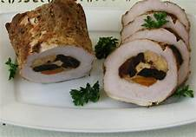
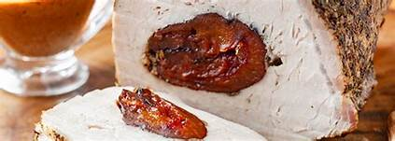
Roasted pork loin with prunes
Components
1 kg of pork loin
300g of dried plums
vegetable oil or olive oil
salt and pepper, ½ packet of dried savory, 1 teaspoon of Provencal herbs
6 toothpicks
¾ cup of broth or water
optional - 1 tablespoon of plum jam

Slide 6
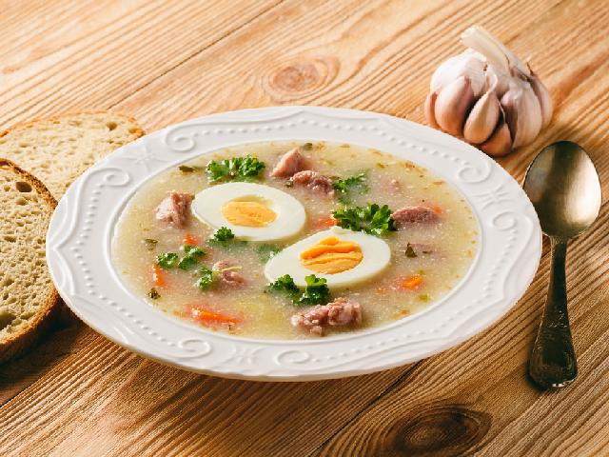
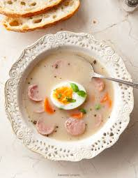
Sour soup
Components / 4 servings
1.5 liters of meat broth or stock
400g smoked pork ribs or bones or smoked or steamed bacon
500g of raw white sausage
500 ml of sour soup (sour soup, sourdough) from the bottle
tablespoons of dried marjoram
1 clove of garlic
6 tablespoons of cream 18% or 30% (for soups and sauces)
And
boiled eggs
e.g. home-made bread
żurek
żurek
żurek

Slide 7
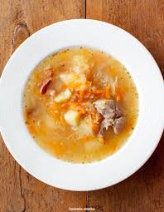
Sauerkraut cabbage soup
Components / 4 – 6 servings
500 g pork ribs
100g of raw smoked bacon
400 g of sauerkraut
600 g of potatoes
2 liters of cold water
1 onion
1 large carrot
1 parsley
a piece of celery
2 sprigs of parsley napkins
spices: about 1 and 1/2 teaspoons of salt, about 1/3 of a teaspoon of ground pepper, 1 bay leaf, 1 allspice, 1 teaspoon of cumin, 1 tablespoon of dried marjoram
1 tablespoon of clarified butter or oil
1 tablespoon of flour

Slide 8
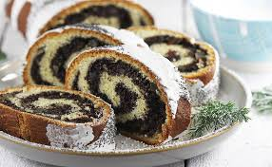
Poppy seed cake
Components / 2 strudels about 35 cm
1. yeast dough
500 g of wheat flour
50g of fresh yeast
200 ml of milk
4 yolks
50 g of butter
2. poppy seed mass
850g of ready-made poppy seeds
2 tablespoons of breadcrumbs
4 proteins
3. And
frosting: lemon juice 1/2 lemon + about 1 cup powdered sugar
4 tablespoons of fried or candied orange peel
optional: 50g of nuts and dried cranberries or raisins

