Slide 1
The Bible - Truth or Myth
Interdisciplinary lesson in Bulgarian language and literature and Religion

Slide 2
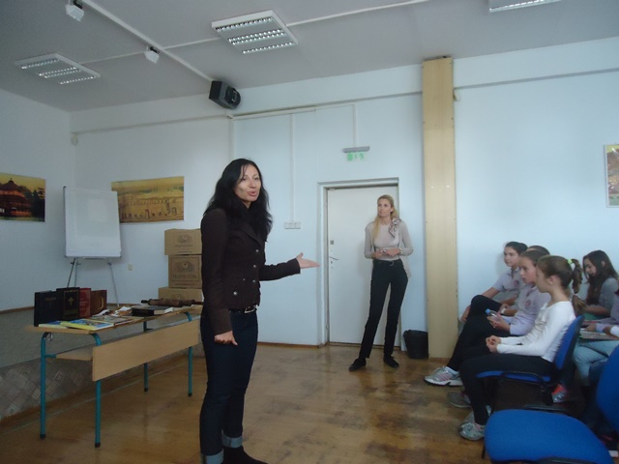
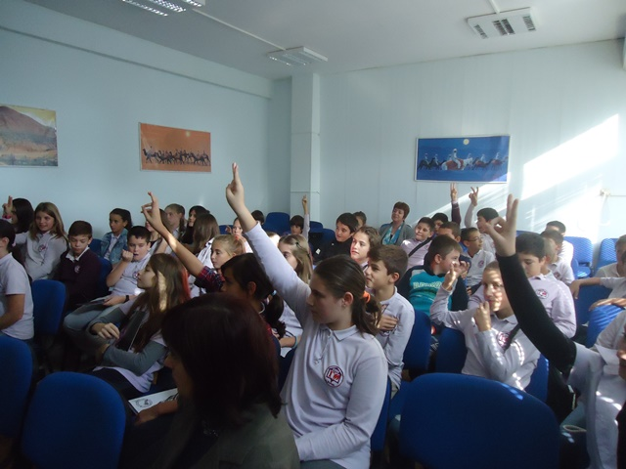
An interdisciplinary lesson in Bulgarian language and literature and Religion on the topic "The Bible - Truth or Myth" was held on 21.10.2016 at "Geo Milev" School- Varna.
Age group: 5th grade students,
Teachers : BLL teachers and Theology teacher

Slide 3
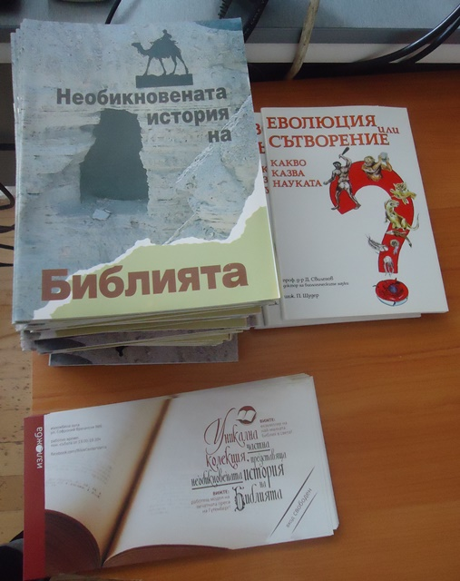
.
The main aim of the lesson is to give children an opinion whether the Bible is a myth or reality

Slide 4
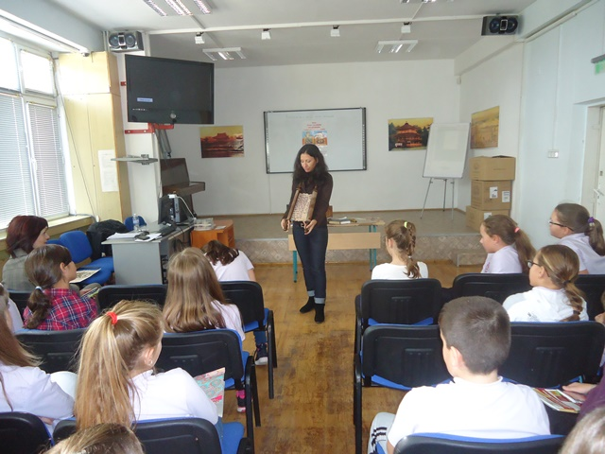
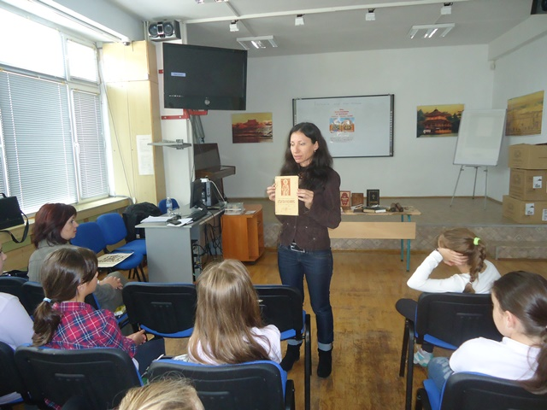
Students can see and touch copies of old manuscripts written on papyrus, parchment and paper. They are also shown a textbook of Religious Teaching from 1943, that was used for their great-grandparents at school when this subject was compulsory.

Slide 5
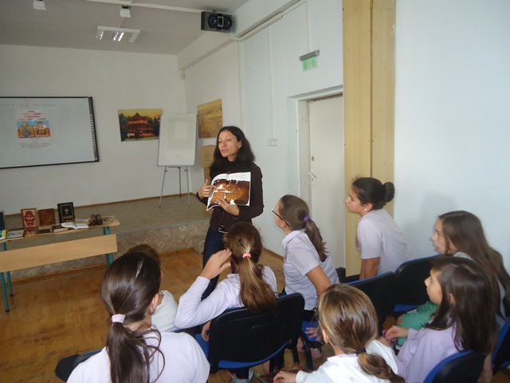
The students have the opportunity to transcribe a Bible verse, the way it was transcribed in antiquity and see how laborious it was.

Slide 6
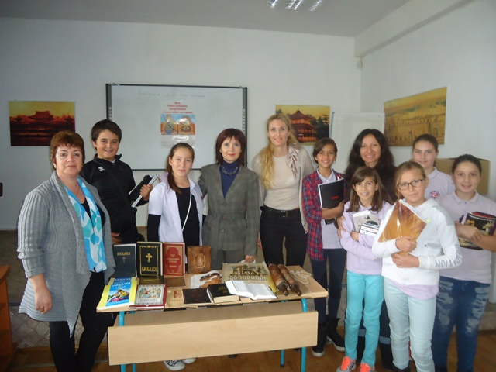
These types of collaborative lessons are common practice as they are usually met with a great interest by the students and are really beneficial for students’ personal development.

