Slide 1
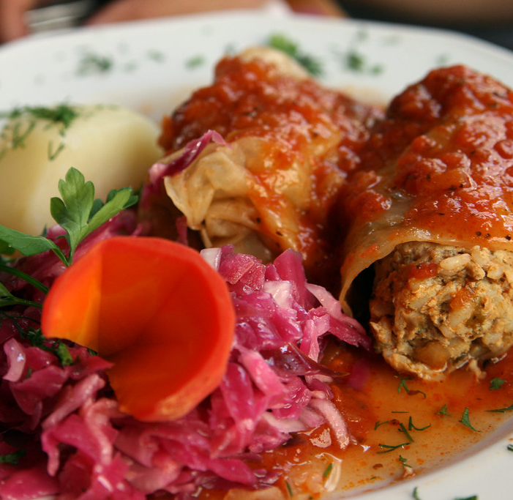
Polish Cuisine
"Gołąbki" - doves
This Photo by Unknown author is licensed under CC BY-SA.

Slide 2
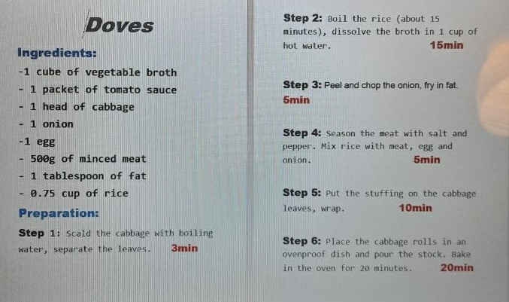

Slide 3
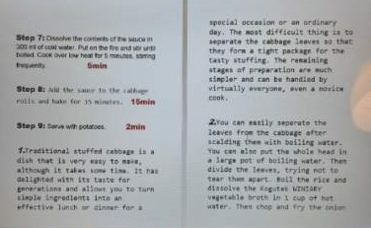

Slide 4
